Slide 1
API Design 2
Frank Walsh

Slide 2
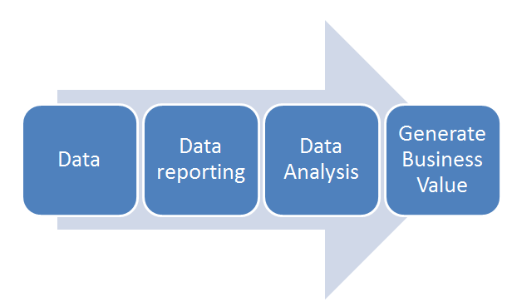
Data Value
Data is now one of the most valuable business assets.
Growing number of web/mobile apps in daily use by business and consumer
Companies use data to personalise and tailor experiences to their customers
Companies analyse customer data and operational behavior to make better decisions

Slide 3
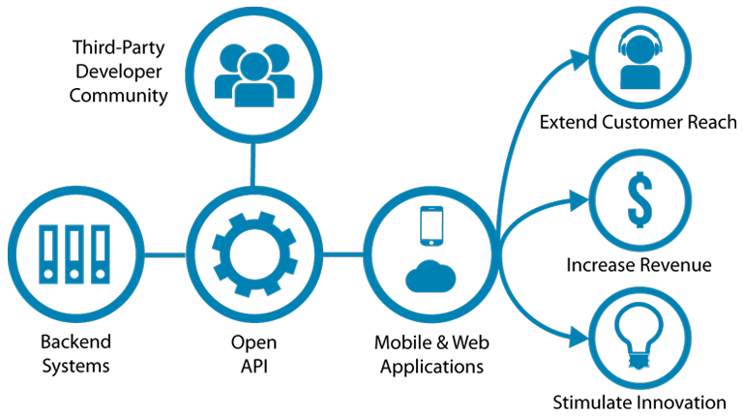
API Value
APIs (application programming interfaces) are the most accessible way to extract value out of stored data.
developers can use them to create new business opportunities and improve existing processes/products
analysts can access new data sources quickly and pull the data into their analytics platforms.
APIs "free" the data from systems.
APIs make the data consumable and reusable.
thus APIs are valuable to a business.

Slide 4

API Internet of Things
Many new IoT devices being released. T
Devices are limited on their own
It's the innovative use of those devices with accompanying APIs that generate value
"Build a better mousetrap, and the world will beat a path to your door" - Ralph Waldo Emerson
Rentokil believe they have using APIs(https://www.computerworlduk.com/it-business/rentokil-on-iot-rat-traps-cash-for-apps-incentives-apis-3612866/)
Rentokil increased operational efficiency through the automatic notifications of a caught animal and its size

Slide 5

APIs - Healthcare
Connected Healthcare
Patients instrumented with sensors connected via Personal Area Networks
APIs crucial to access patient data, providing new ways for physicians to engage and connect with those patients through web, mobile, and social apps
Administration
APIs provides access to data to better predict staff requirements, thus reducing overtime costs and better serving patients.
APIs can facilitate record sharing with other hospitals and medical offices

Slide 6
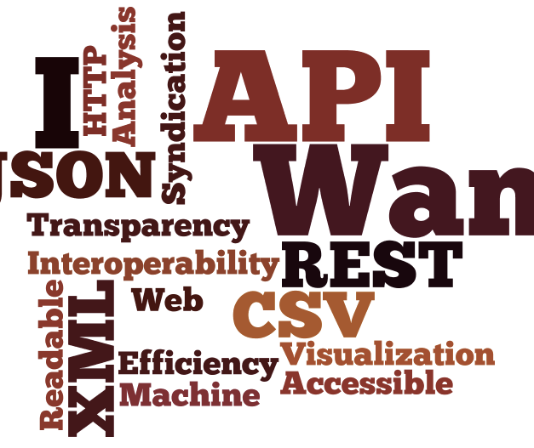
API - Cloud
Companies going through "Digitial Transformation"
Moving from traditional systems to cloud-based digital systems
Many adopt "Hybrid" approach
Moving parts of IT estate to cloud
Emphasis on APIs to unlock data and capabilities in a reusable way.
"Microservice" architecture popular
Cloud APIs provide high availability/scalability
better cope with spikes in demand and make efficient connections, enabling them to adapt and innovate faster
On-premises APIs can unlock legacy systems and connect them with cloud applications

Slide 7

APIs – Facilitating omnichannel
industries starting to use omnichannel strategy to attract and retain customers.
Omnichannel provides a seamless shopping experience whether the customer is shopping online from a desktop or mobile device, by telephone or in a bricks and mortar store.
Well designed and provisioned APIs crucial to create a link between cloud, on- premises systems and mobile.
E.G.
eyewear retailer offers convenience and choice to its customers through a huge online selection. Also provides custom fittings or repairs in their brick and mortar stores.
Store app integrates with BLE beacons in Bricks and Mortar shop. Provides focussed deals to encourage sales. "these trainers would look great with the trousers you bought last week. Buy today and get 20% off!"

Slide 8
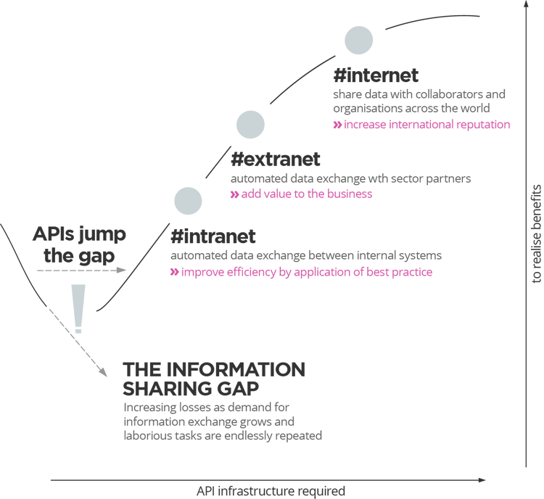
The API Economy
Enterprises will adopt an API strategy. For some it’s their main product.
APIs enable greater agility and efficiency within their organisations
innovation in emerging startups forcing more established companys to innovate/evolve/acquire (e.g. Uber/Slack)
survey conducted by Mulesoft found:
80 percent of large enterprises (10,000 employees or more) said that their company currently makes more than $5 million a year from APIs.
API strategy was one of the top three priorities to an organization’s business plans

Slide 9
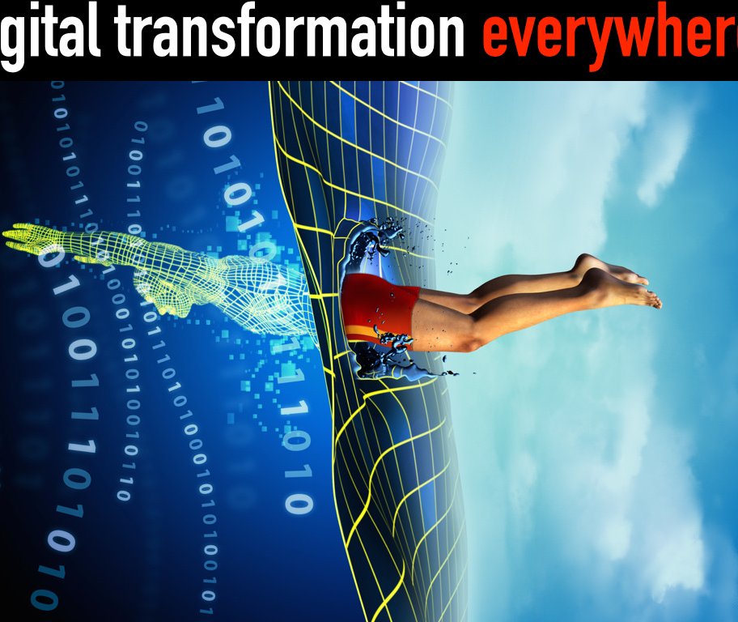
Digital Transformation
IT architecture underpinning APIs also need to evolve
Can't just deploy tech (APIs/cloud/elasticity) on top of existing monolithic systems and processes and expect everything to be better.
Need to embrace architectures (both technical and orginisational) that support microservices, mobile apps, and Internet of Things.

Slide 10
References
"How Rentokil innovates using APIs", https://www.computerworlduk.com/it-business/rentokil-on-iot-rat-traps-cash-for-apps-incentives-apis-3612866/
"The Rising Value of APIs", Whitepaper , https://www.mulesoft.com/lp/whitepaper/api/rising-value-apis
"Connected Healthcare", https://www.wsj.com/articles/why-connected-medicine-is-becoming-vital-to-health-care-1435243250

